Slide 1

nanocosmos: SME Booth TT5
nanoStream Cloud &
H5Live Player
True interactive live streaming
to engage your audience
Ultra-Low-latency (ULL) Live Streaming
nanoStream Cloud: CDN with a global scale
H5Live: HTML5 playback on any device
Oliver Lietz, Founder/CEO, nanocosmos.de, Berlin
lietz@nanocosmos.de
V190502

Slide 2


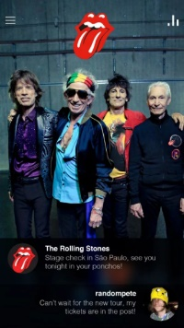


nanoStream Cloud Use Cases for Interactive Live Streaming
Audience Engagement / Gamification
„Vertical“ Use Cases: Going beyond OTT/broadcast
    Live Meetings
    Enterprise Webcasts
    Education
    Screen Sharing
    Auctions
    Gambling
    Quiz Shows
    iGaming
    Monitoring/Security
    Search and Rescue
    Social Media
    Influencers
    VR/360
    Mobile First!
https://www.nanocosmos.de/blog/use-cases/
Credits: HQ Trivia/GAVL/DroneSAR/Realtimebox/DiscipleMedia/M.Schwartz-Unsplash/Press

Slide 3
nanoStream Use Cases: Trivia Game Show
  Quiz Show: Partnering with Realtimebox
  Moderator: asking questions
  Audience: realtime feedback / bets / prizes
  Plugin-free: HTML5 / Web Browser Application / No app
  Ultra-Low-Latency: around 1 second end-to-end
  Global scale to large audiences

Slide 4
nanoStream Use Cases: Live Auctions and Betting
  Live Auctions and Betting:
  Auction: e.g. real estate venue Betting: e.g. horse racing
  global audience, realtime bid
  App or Web based: iOS/Android Live Encoder / HTML5 Web Live Player
  Ultra-Low-Latency: around 1 second end-to-end
  Global scale to large audiences
  Gamification of business applications

Slide 5

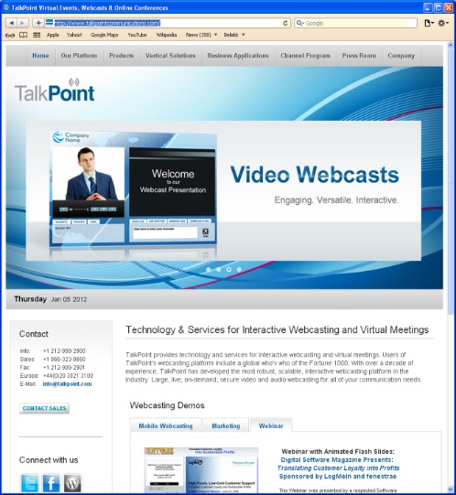
nanoStream Use Cases: PGi / Talkpoint Convey
  Live Conferencing / Webcasting:
  Corporate Chat/Audio/Video-Broadcast / Screen Sharing
  Plugin-free: HTML5 / Web Application
Interaction:
Q&A
Polls
Feedback
  Ultra-Low-Latency: around 1 second end-to-end
  Global scale to large audiences

Slide 6
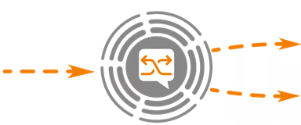
Interactive Live Streaming
What do you need?
Streaming Technology
  Camera/Live Encoder
  Streaming Server/Service
  Delivery/Player: Ultra-Low-Latency
  Cross-platform: all HTML Browsers
Network
  Global CDN and Audience of any size
  Managed Platform / Easy to use
Metrics / Analytics
  Provide insight on QoS

Slide 7


Live Video Streaming – current standards: HLS / DASH
Live Encoding
Live Streaming / Delivery
Live Playback
Live Encoder
RTMP
Live Player
HTTP Segments
(HLS, DASH, fMP4)
HLS: Long Latency!
  HLS/DASH: HTTP Segments/Chunks and buffering create long latency (6-30s)!
  Suitable for OTT/Broadcast, but not for interactive live streaming (1s)

Slide 8
Latency values
High
Latency
Typical
Latency
Low
Latency
Ultra Low
Latency / Interactive
RTMP
HLS/DASH
HTTP-based file chunks
CMAF
H5LiveTM
LL-HLS / MSE / fMP4
nanoStream
Cloud
WebRTC
Peer-to-peer
60+
45
30
10
6
4
3
2
1
0.5
0.2
Latency / seconds

Slide 9
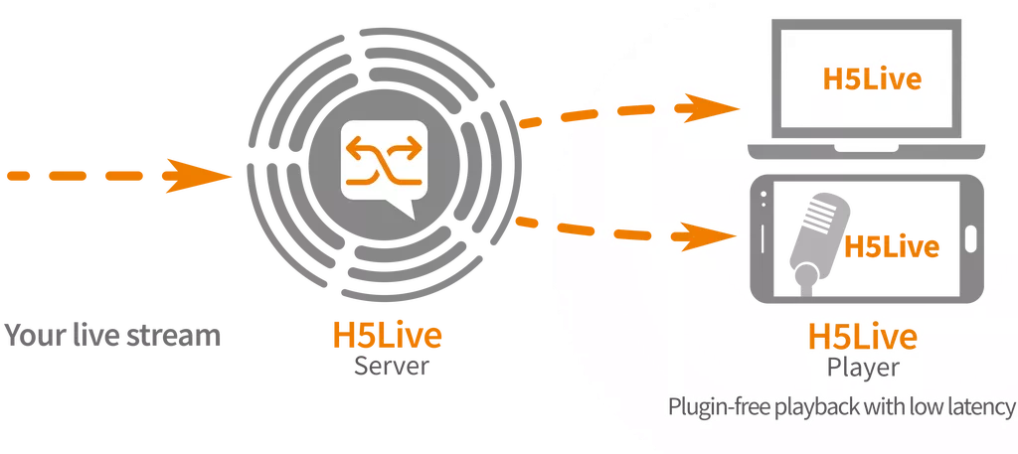
Technology: nanoStream H5Live Player
Unique Technology created by nanocosmos
Ultra-Low-Latency (ULL)
Plugin-free / All HTML5 Browsers
RTMP/H264/AAC
WebRTC
TCP/UDP
All HTML5 Browsers

Slide 10
nanoStream Cloud / H5Live Player for ULL Live Streaming
nanoStream H5Live Player
Ultra-Low-Latency (ULL)
Plugin-free
All HTML5 Browsers
  3 delivery formats, device-dependent:
  (H5Live is NOT chunk-based, and not WebRTC!)
  WSS (Websocket)
  LL-HLS (Low-Latency HLS)
  fMP4 (progressive fragmented MP4)
1
2
3
WSS
1
2
ULL-HLS
RTMP/H264/AAC
WebRTC
TCP/UDP
fMP4
3
All HTML5 Browsers
nanoStream Cloud

Slide 11
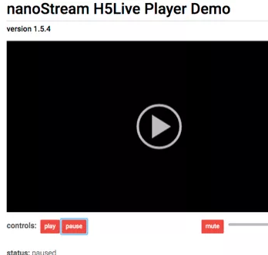
H5Live Player - on your own web page
  Easy to embed on HTML5
  (light-weight Javascript-Client)
nanoStream
Cloud/ ULL CDN
player.setup( {
"source": {
”stream": ”XXX-YYY"
}};
  Same player working on all HTML5 browsers: Desktop and Mobile, Windows, Mac, iOS, Android:
  Chrome, Firefox, Safari, Edge, IE, … !

Slide 12


nanoStream Cloud
Global scalable CDN
Any number of live sources
instant live streaming
Many-to-many
ULL Live Stream
nanoStream H5Live Player
ULL Playback
on all HTML5 browsers
Feedback/2-Way interaction

Slide 13
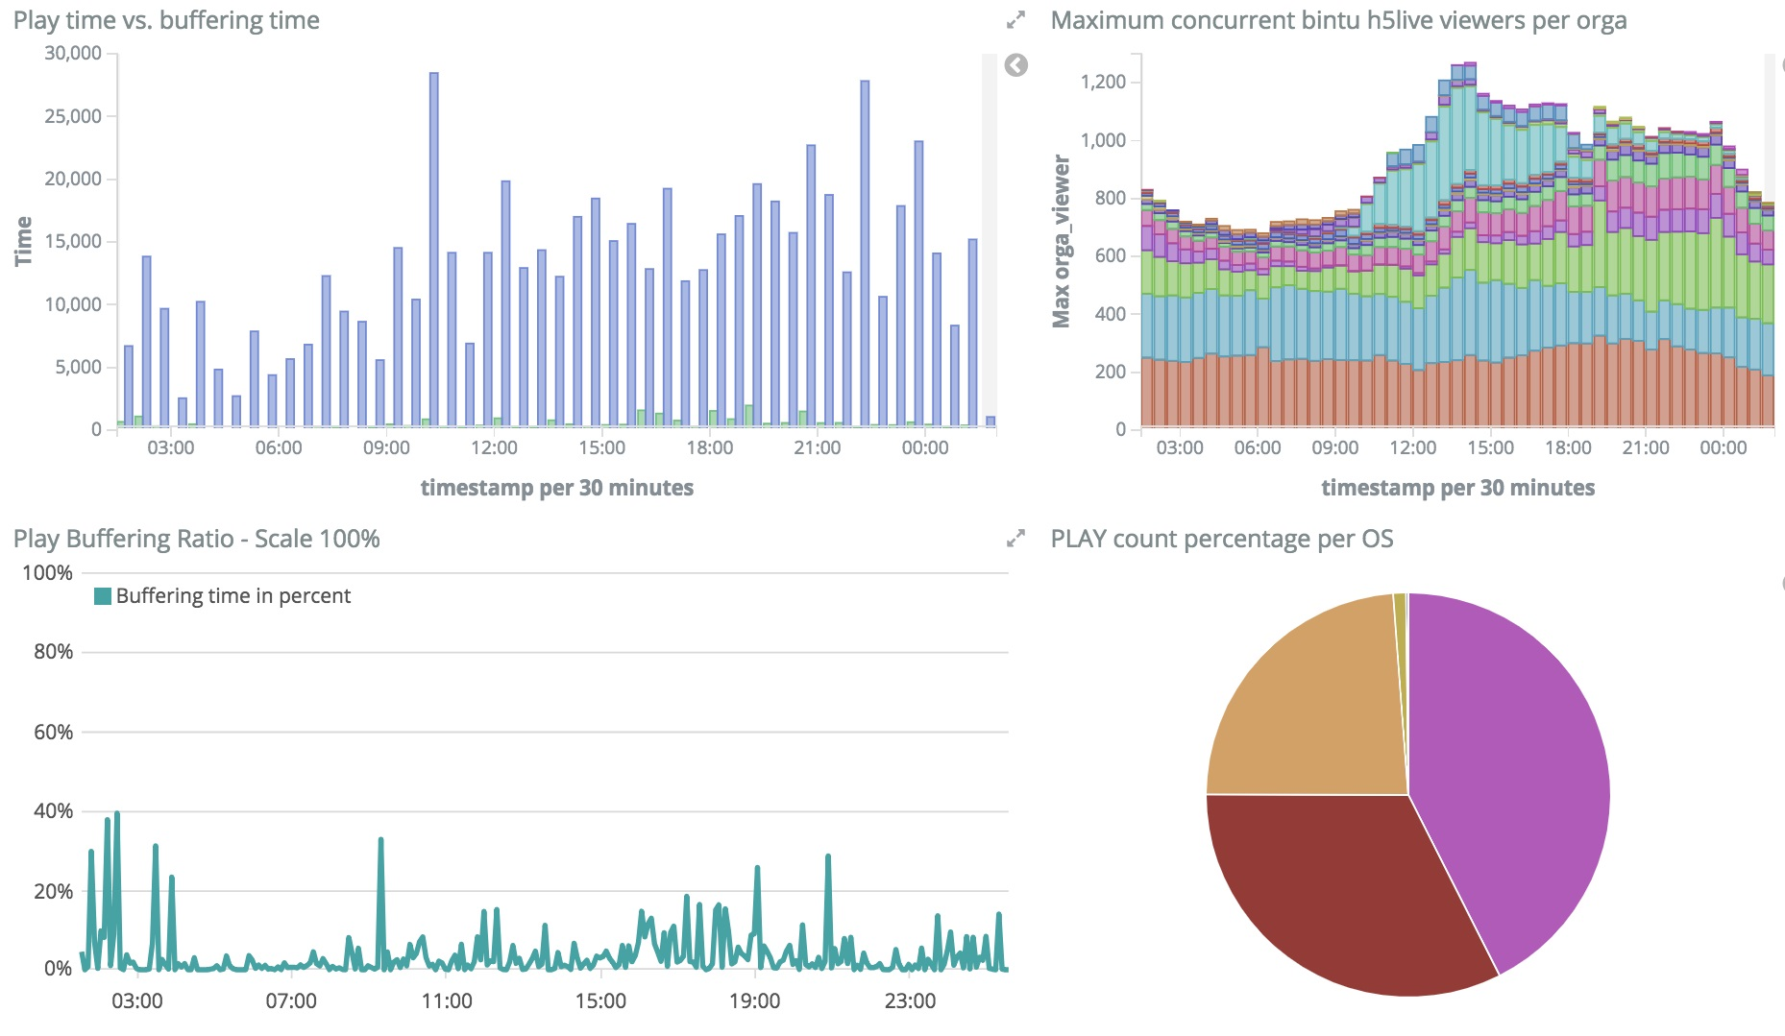
nanoStream Metrics / Analytics
End-to-end QoS – Full control of the whole workflow / glass-to-glass

Slide 14
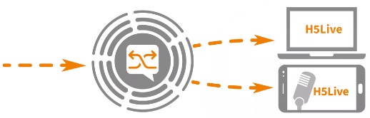
nanoStream Cloud + H5Live Player
Interactive Live Video Streaming with Ultra-Low Latency
Live Encoding
Live Streaming / Delivery
Live Playback
nanoStream Cloud
Live Encoder
Hard- or Software
RTMP/WebRTC/SRT
nanoStream, OBS,
Videon, Teradek, JVC, …
nanoStream
H5Live Player
ULL: 1 second
2-way Interaction / Feedback
HTML5: All Browsers
  Audience: worldwide distribution, scalable
  Cross-platform: any device, all browsers, plugin-free (HTML5)
  Integration / Ease of use / End-to-end solution
  Metrics/Analytics for high QoS: End-to-end

Slide 15
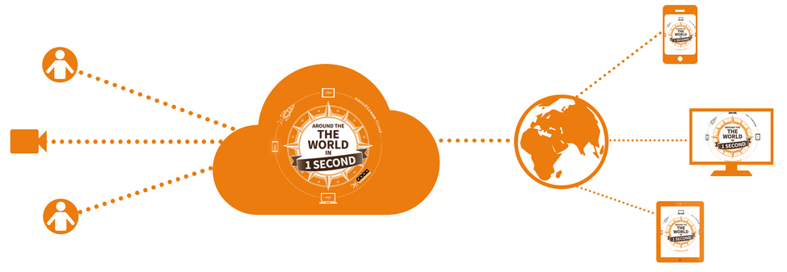
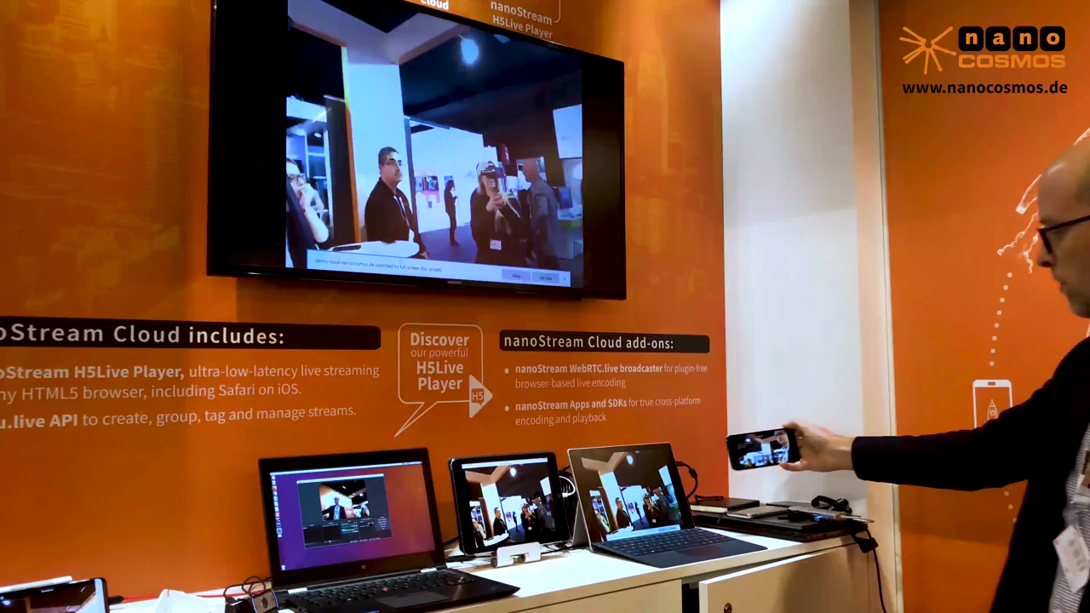
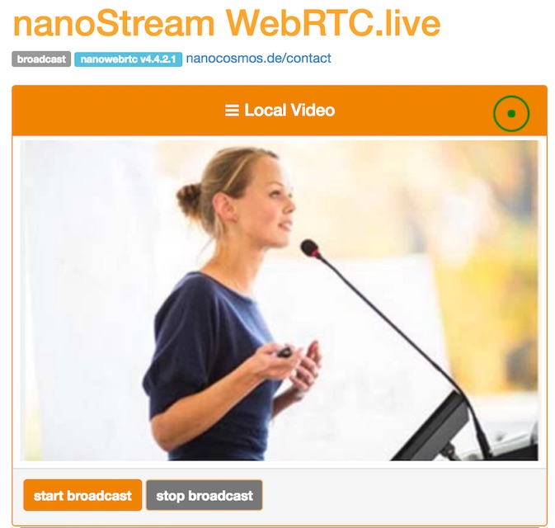
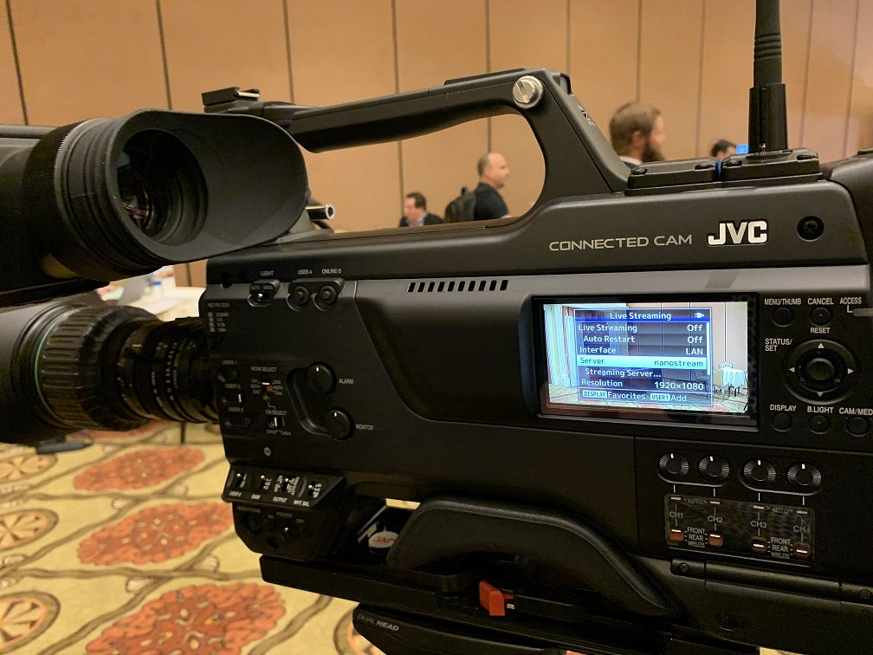
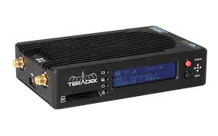
nanoStream Cloud & H5Live Player
Flexible Encoder Setups: Any Live Source
Mobile Apps, HW/Cameras, WebRTC/Browser, FMLE, OBS, …
nanoStream Cloud/
CDN
H5Live Player working on all browsers
Ultra-Low-Latency 1 second end-to-end
Try yourself: nanocosmos.de/h5live

Slide 16

Live Encoding / Streaming: Videon + nanoStream
Seamless operation of live encoder hardware and ULL live streaming platform
Videon Versa Streamer for HDMI and SDI Cameras, nanoStream Cloud & H5Live
Contact: Todd Erdley, videon-central.com, Oliver Lietz, nanocosmos.de

Slide 17
nanoStream Cloud & H5Live Player
Example Setup: browser-based webcast
nanoStream Cloud/CDN
nanoStream
WebRTC.live
Broadcaster
H5Live Player. (not WebRTC)
Easy to integrate with your existing setups!
Option: Use nanoStream Apps/SDKs
Option: Use plugin-free WebRTC broadcast
H5Live Player working on all browsers
Ultra-Low-Latency 1 second end-to-end

Slide 18
SME Booth TT5
nanoStream Cloud &
H5Live Player
Interactive live streaming with ultra-low-latency
  Global scale: go live around the world in 1 second
  Cross-platform: ALL HTML5 browsers, incl. iOS
  End-to-end: Live Encoding / Playback / ULL CDN
  Light-weight: instant live streaming and playback
  Private label / API / SDK (browser based and native)
  Integrates with existing Live Encoding setups
  Metrics & Analytics (end-to-end)
Try nanoStream Cloud as your low latency CDN
for your interactive content now !
nanocosmos.de/demo
Questions & Answers
Oliver Lietz / sales@nanocosmos.de
SME Booth TT5
www.nanocosmos.de

Slide 19
Misc material

Slide 20
Interactive Live Streaming
What do you need?
  Technology:
  Ultra- Low-Latency Playback, all HTML Browsers
  Network: Audience with global scale
  End-to-end solution
  Integration / Ease of use
  Metrics/Analytics for high QoS: End-to-end

Slide 21
nanoStream Cloud & H5Live Player
Interactive Live Streaming
  What is H5Live?
  H5Live Player: all HTML5 browsers
        Playback in ultra-low latency (ULL)
  Light-weight and easy to use
  Can integrate with existing solutions
  Integrated with nanoStream Cloud
  Global scale: ULL-CDN
  Around the world in 1 second!
  Accelerates mobile audiences
RTMP/WebRTC
H264/AAC
nanoStream
Cloud
Continuous stream
Ultra-Low Latency: 1s
2-way Interaction / Feedback

Slide 22
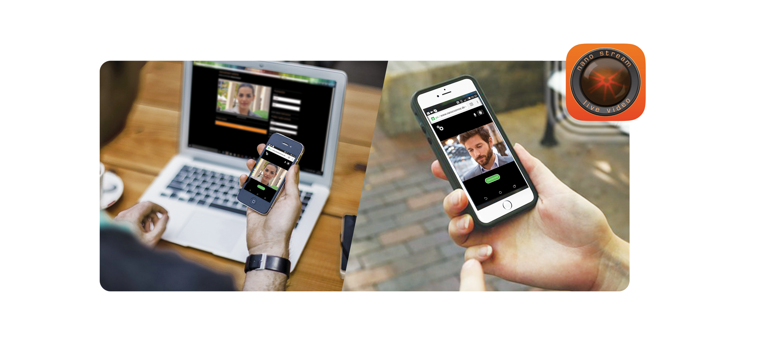

Interactive Live Streaming / Ultra Low Latency (ULL)
Ultra-low-latency
Cross-platform/any device
Feedback channel / bidirectional
Plugin-free/all browsers, incl. iOS
Scalable to any audience
Worldwide availability
ULL is always end-to-end / glass-to-glass, camera, encoder, network, player

Slide 23
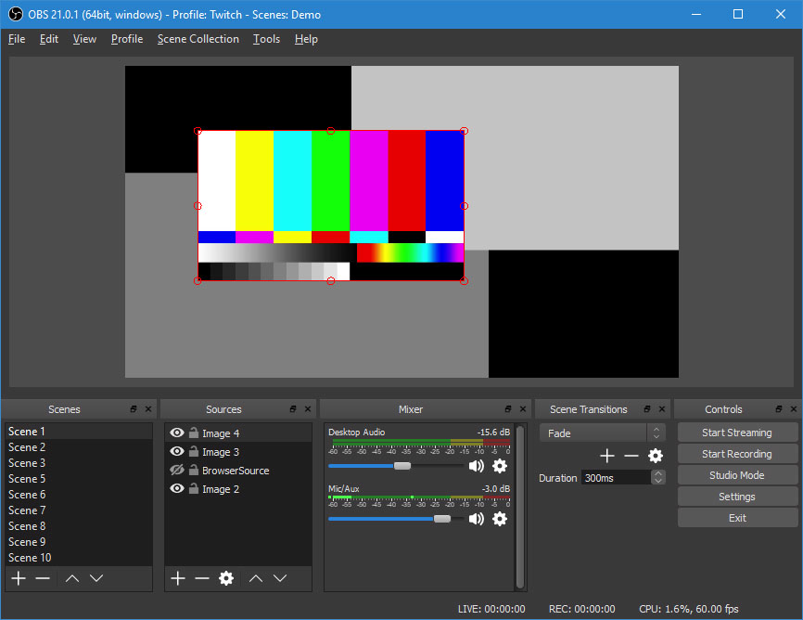
nanoStream Cloud & H5Live Player Setups
Example Implementations & Setups – Easy to integrate
Option: Use your existing Cam / Live Encoder: Easy to integrate! (OBS, Wirecast, Elemental, …)
Option: Use nanoStream Apps/SDKs: white label apps
Option: Use plugin-free WebRTC broadcast for webcast
All working with H5Live Player - ULL Playback on all browsers!
nanoStream Cloud/CDN
H5Live Player

Slide 24
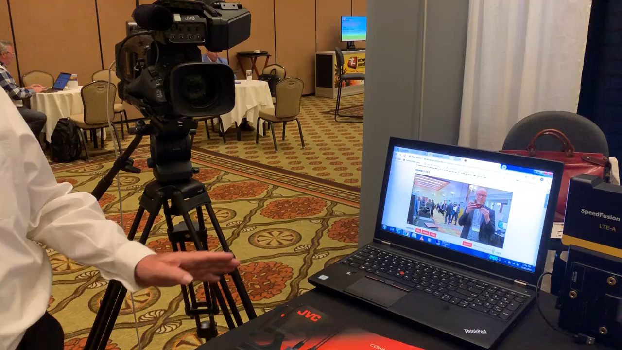
nanoStream Cloud & H5Live Player
Example Setups
JVC Connected Cam – RTMP Live Encoder / Upstream directly from the cam
nanoStream Cloud/CDN

Slide 25
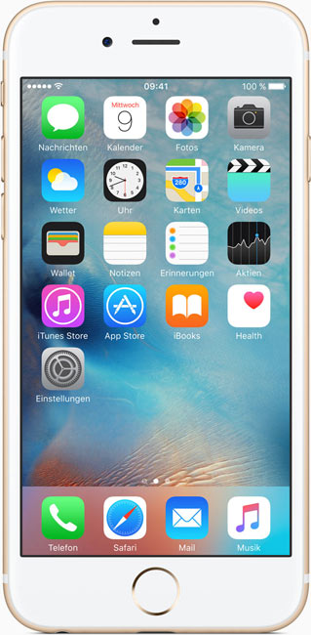
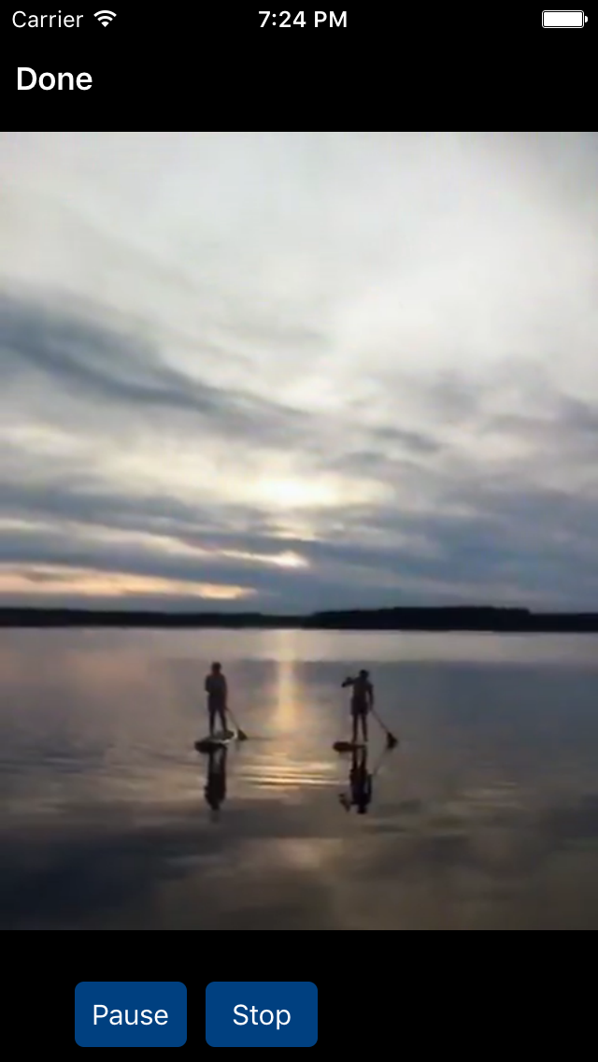



Live Streaming - How does it work?
Live Encoding
RTMP
WebRTC
SRT
nanoStream SDK/Apps
Or Your Own Encoder
Streaming Service
(REST API / RTMP)
nanoStream Cloud
Live Playback
(or web player)
nanoStream
H5Live
All HTML5 browsers

Slide 26

Oliver Lietz, Founder/CEO
Berlin based since 1998
Cross-Platform Live Streaming SDKs
White Label / B2B
Low-Latency Live Streaming End-to-End
nanoStream Cloud
  H5Live Player (HTML5)
  Global Scale / CDN
  Cross-Platform/Any Device
  Launched 2016
Consulting/Support/24/7
www.nanocosmos.de / lietz@nanocosmos.de

